Slide 1
5semester - CRYPTOGRAPHY AND NETWORK SECURITY(CSE55)
Date: 18/12/2023
Title:
Ramaiah Institute of Technology
Department of Computer Science and Engineering
CipherCraft – A Randomized Encryption/Decryption Adventure
Team members - Name : Aryan Anchalia (USN) 1MS21CS030
Name : Anirudh Sanal Kumar (USN) 1MS21CS017
Name : Aneesh M Somayaji (USN) 1MS21CS016
Name : Ankit Kumar Singh (USN) 1MS21CS020
DEPARTMENT OF COMPUTER SCIENCE AND ENGINEERING

Slide 2
Agenda
Introduction
Literature Survey( Any 4 related papers)
Problem statement and objectives
Methodology
Results and Disucssion
Conclusion
References
DEPARTMENT OF COMPUTER SCIENCE AND ENGINEERING

Slide 3
Introduction
CipherCraft unfolds as an enthralling encryption and decryption adventure, encapsulating the essence of security and exploration.
The project delves into the intricacies of diverse encryption techniques, employing a range of methodologies such as RSA, Hill, Playfair, Keyed Transposition, Keyless Transposition, Affine, Autokey, and Vigenère ciphers.
A unique facet of the program lies in its dynamic approach, where a random encryption technique is autonomously selected in the program, ensuring each encryption process is a distinct cryptographic encounter.
The generation of encryption keys is integral to this process, with users having the option to input their own keys or alternatively, rely on the compiler for random key generation.
The smart advantage of this method is that, the secret messages become puzzling to potential enemies, hiding the specific way of coding behind an unpredictable cover.
DEPARTMENT OF COMPUTER SCIENCE AND ENGINEERING

Slide 4
Literature survey
Sl.No. | Title of the paper | Year | Methodology Used | Outcome of the work
1 | A Classical Cipher - Playfair Cipher and Its Improved Versions | 2021 | Generate a 5x5 key matrix using a keyword, omitting duplicate letters and combining 'I' and 'J'. For encryption/decryption, process the plaintext in pairs, finding corresponding ciphered/deciphered pairs using the key matrix. | Concluding with an evaluation of the improved Playfair cipher versions, the paper anticipates future developments in Playfair cipher and cryptography, emphasizing their continued significance in data protection.
2 | Breaking Affine Ciphers using Machine Learning Techniques | 2019 | Applied machine learning algorithms like Support Vector Machines to automate the cryptanalysis of Affine ciphers, achieving high accuracy in key prediction. | Demonstrated the potential of machine learning for efficiently breaking simple ciphers, highlighting the need for stronger encryption techniques.
3 | A Novel Approach to Hill Cipher | 2023 | Proposed a modified Hill cipher using non-invertible key matrices and explored cryptanalysis techniques like known plaintext attack and chosen plaintext attack to break the cipher. | Demonstrated the vulnerability of the modified Hill cipher even with non-invertible keys and proposed modifications for improved security.
4 | Design and Security Analysis of a New Autokey Stream Cipher based on Chaotic Logistic Map | 2022 | Developed a new autokey stream cipher utilizing the chaotic Logistic map and analysed its security against common cryptanalysis attacks. | Proposed cipher exhibited strong pseudo-randomness and resistance against linear and statistical attacks, offering potential for secure communication applications.
DEPARTMENT OF COMPUTER SCIENCE AND ENGINEERING

Slide 5
Problem statement and objectives
Many existing encryption methods rely on well-documented algorithms, making them susceptible to attacks by adversaries with prior knowledge of these algorithms. Hence we aim to solve this by means of developing a secure encryption system that employs randomized cipher techniques, to conceal the underlying algorithm, thereby preventing attackers from predicting the encryption method that has been used and carry out the attack.
This randomized cipher technique has the following objectives :
Efficiency: Maintain a practical level of efficiency despite introducing randomness.
Integration Compatibility: Ensure seamless integration with existing communication protocols, data storage systems, and applications.
Unpredictability: The encryption process should be inherently unpredictable and technique employed is completely randomized.
DEPARTMENT OF COMPUTER SCIENCE AND ENGINEERING

Slide 6
Non-deterministic Encryption: Develop an encryption system that exhibits non-deterministic behaviour, ensuring that the same plaintext does not produce identical ciphertext.
Variable Key Space: Implement a randomized cipher technique that allows for a dynamically changing key space, making brute-force attacks significantly more challenging by introducing a large and unpredictable set of potential encryption keys.
Resilience to Known-plaintext Attacks: Design the encryption system to be highly resistant to known-plaintext attacks, where an attacker has access to pairs of plaintext and corresponding ciphertext.
The goal is to create an unpredictable and adaptable encryption process that maintains efficiency, undergoes rigorous security analysis non-deterministically, and seamlessly integrates with existing technologies thereby enhancing the overall data protection in digital communication and storage systems.
DEPARTMENT OF COMPUTER SCIENCE AND ENGINEERING

Slide 7
Methodology
We have aimed at covering all the different categories of ciphers, that are :
Both Monoalphabetic (which uses a single valued keys :- Affine cipher) as well as Polyalphabetic (which uses multi-valued keys :- Autokey, Hill, Vigenère, Playfair ciphers) under Substitution ciphers.
Both keyed and keyless, under Transposition ciphers. These dealt with here are Symmetric key ciphers( which use the same key for encryption as well as decryption).
And as for Asymmetric key ciphers( using different keys for encryption and decryption), the RSA algorithm has been implemented.
DEPARTMENT OF COMPUTER SCIENCE AND ENGINEERING

Slide 8
Finally, the cipher techniques used in the project are :
Affine Cipher
Autokey cipher
Keyed transposition Cipher
Hill cipher
Vigenère cipher
Keyless transposition cipher
RSA cryptosystem
Playfair Cipher
DEPARTMENT OF COMPUTER SCIENCE AND ENGINEERING

Slide 9
The program uses a menu-driven mechanism between all of the 8 methods incorporated except that the user cannot determine which cipher method to be implemented, owing to a completely randomized value generated, based on which the respective function of that corresponding technique is called.
The plaintext entered by the user is thus encrypted by that function, by means of a key appropriate to that particular technique, entered by the user.
An alternative to this code also been implemented, wherein we have randomly generated the key appropriate to that technique, which adds an additional layer of security to the data and increases the complexity for the attacker to decipher the plaintext.
The next time around for the subsequent plaintexts, a new “unknown” technique is used with a completely newly generated key.
DEPARTMENT OF COMPUTER SCIENCE AND ENGINEERING

Slide 10
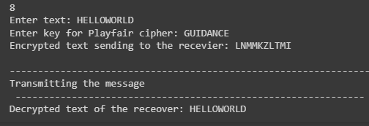
Results and Disucssion
We can see that for the plain-text “HELLOWORLD” we can generate different cipher –text using different cipher techniques. Though this can be done by using different keys for a particular cipher technique, it is still not safe as if the attacker knows the cipher technique used, the attacker can decrypt the message easily compared to when different ciphers are used.
Results for :-
1. Taking key from user(sender) for each cipher technique :
DEPARTMENT OF COMPUTER SCIENCE AND ENGINEERING

Slide 11
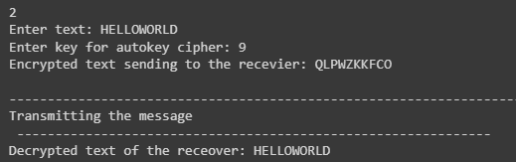
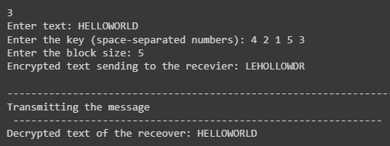
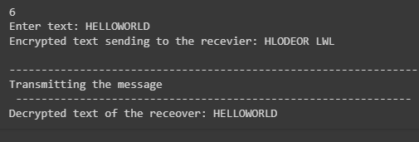
DEPARTMENT OF COMPUTER SCIENCE AND ENGINEERING

Slide 12
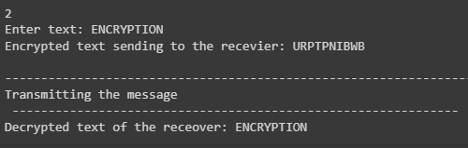
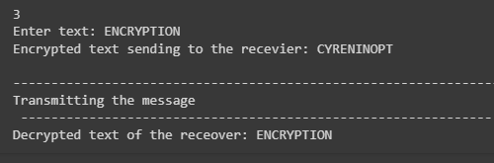
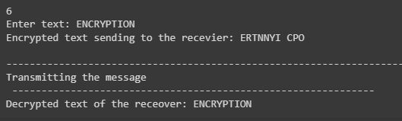
2. Random generation of the key for each cipher technique :
DEPARTMENT OF COMPUTER SCIENCE AND ENGINEERING

Slide 13
Conclusion
In conclusion, the implementation of a random cipher technique for encrypting user plaintext, coupled with the generation of a unique random key tailored to the specific technique, constitutes a robust and innovative approach to data security. By introducing an element of unpredictability into the encryption process, the project successfully mitigates the risks associated with algorithm predictability. The dynamic adaptation of the key space and entropy injection enhances resistance against various cryptographic attacks. Moreover, the seamless decryption process ensures the secure retrieval of the original plaintext, providing a comprehensive solution that not only safeguards sensitive information but also elevates the overall integrity and resilience of digital communication and data storage systems.
DEPARTMENT OF COMPUTER SCIENCE AND ENGINEERING

Slide 14
References
[1] Learning Vigenère Cipher through Gamification: An Educational Design Research, Mohammed Yahya Alghamdi and Younis A. Younis, 2020.
[2] Breaking Affine Ciphers using Machine Learning Techniques, Otokar Grošek and Pavol Zajac, 2019.
[3] A Classical Cipher - Playfair Cipher and Its Improved Version, Yuzhe Wangs, 2021.
[4] Design and Security Analysis of a New Autokey Stream Cipher based on Chaotic Logistic Map, 2022
DEPARTMENT OF COMPUTER SCIENCE AND ENGINEERING

Slide 15
THANK YOU
DEPARTMENT OF COMPUTER SCIENCE AND ENGINEERING

